Slide 1
In-person networking Faculty SLIDE (1 of 4)
Workshop Overview
Workshop Details
Duration: 90 minutes (adjustments can be made)
Participants: 6 to 20 participants
Instructors: 2 or more instructors
Delivery Requirements
Technology Requirements: Laptop with Internet connection – for instructor use ​ Projector and screen – to display presentation​ Computers with internet connections – for participants​ Printer – for printing materials Room Recommendations: Tables and seating for participants (arranged for groups of 2 to 5) Adjustable lighting and/or window blinds Materials & Supplies Needed: Workshop materials, as specified on slide 2 Whiteboard or flip chart – 1 at the front of the classroom Notepaper or pads – for participants Pens or pencils – for participants Paper and colored markers – for activity
Learning Objectives
Explain networking and its benefits. Identify who is already in your network. Learn in-person network building techniques. Describe the purpose and parts of an elevator speech. Create, practice, and critique an elevator speech.
Prerequisites
Mobile - Expand Your Network​ (10 minutes) Mobile - Networking Technique (15 minutes)
Notes:
FACULTY INSTRUCTIONS
Use Faculty Slides 1-4 to prepare to deliver the course.
NOTE ABOUT PREREQUISITES:
The online courses are strongly encouraged. Slide notes marked Online Content are a review of online content. If your learners have taken the online courses, then you may review these slides more quickly; however, be aware that the workshop assessment includes this material, so your audience must show they know it before you move on. If learners have not taken the online course, then plan to spend the indicated time on these slides.
INTELLECTUAL PROPERTY NOTICE:
Organization staff and/or instructors may modify workshop materials to fit the time available, introduce instructors and ensure applicability to the audience.
Workshop materials are copyrighted by Accenture. Any content that you add must be labeled with the appropriate copyright statement and/or attribution to the intellectual property owner and to clarify that the added content is not owned by or created by Accenture.
If you wish to modify the workshop materials beyond these parameters, please contact the Skills to Succeed Learning Exchange Team to discuss your needs.
Copyright © 2019 Accenture. All rights reserved.
In-Person Networking Workshop Faculty Guide
1

Slide 2
In-person networking Faculty SLIDE (2 of 4)
Materials and Print Specifications
DIGITAL AND ONLINE MATERIALS | LOCATION
Faculty Prep Video and Faculty Materials Package | Instructor Materials page
Workshop Assessment and Participant Feedback Survey | Workshop Assessment page
ITEMS IN FACULTY MATERIALS PACKAGE | FILE NAME | PRINT QUANTITY
Faculty Guide | 00 In-Person Networking Faculty Guide.pdf | 1 per instructor
Presentation Slides | 01 In-Person Networking.ppt | n/a
Elevator Speech Worksheet | 02 Elevator Speech Worksheet.docx | 1 per participant 1 per instructor
Elevator Speech Feedback Form | 03 Elevator Speech Feedback Form.docx | 2 per participant 1 per instructor
Notes:
FACULTY INSTRUCTIONS
This slide lists all digital materials, online content, and materials to be printed and the quantity needed. All materials are available to you on the Instructor page. Plan to print materials as specified for learner use during the workshop.
IMPORTANT:
Faculty Slides 1-4 are for faculty preparation purposes. They are hidden and not to be presented.
The remaining slides contain the workshop content and activities, and the slide notes contain detailed instructions and guidance for delivering the content and activities on each slide.
The Faculty Guide contains all slides and slide notes in an easy-to-print PDF file. If you change the slide presentation or notes and would like to reprint, then select Notes Page view and Grayscale when printing.
NOTE:
This course briefly touches on personal brand, as personal brand words are used in elevator speeches. The concept is covered further in the Online Networking workshop, which focuses on using social media for networking and developing a LinkedIn profile. If you decide to combine the workshops, remember that participants need to complete both workshop assessments.
Copyright © 2019 Accenture. All rights reserved.
In-Person Networking Workshop Faculty Guide
2

Slide 3
In-person networking Faculty SLIDE (3 of 4)
Faculty Prep / Pre-Workshop – Instructor Roles & Responsibilities
FACULTY PREP / PRE-WORKSHOP CHECKLIST
 | Print and review the Faculty Guide.
 | Watch the Faculty Prep video for high-level instructions about delivering the workshop.
 | Prepare examples to share regarding: How networking has helped you/been important in your career journey Examples of people in your network In-person networking tips you have learned
 | Create your elevator speech. Prepare to deliver it to the class as a demonstration of an effective elevator speech.
 | Update the “Meet Your Instructors” slide as desired.
 | Practice delivering the presentation content using the suggested timings and key messages.
 | Understand all activity instructions and logistics, such as timing, materials, and how to organize groups.
 | Print materials and create copies for participants as specified on slide 2.
 | Visit the classroom and ensure it meets requirements and has the necessary supplies.
 | Before participants arrive: Adjust the room (lighting, seating, placement of flipchart, etc.) as needed to accommodate participants and activities.​ Set up your laptop, practice using the projector, connect to the Internet, display presentation, etc.​ Place materials in an easy-to-access location for distribution during the workshop.​ Locate restroom facilities in case participants ask.
Notes:
FACULTY INSTRUCTIONS
Use the information on this slide to complete all necessary steps before the workshop.
If desired, consider inviting a guest speaker from a local business or college to share compelling stories about in-person networking in the “real world.”
Copyright © 2019 Accenture. All rights reserved.
In-Person Networking Workshop Faculty Guide
3

Slide 4
In-person networking Faculty Slide (4 of 4)
During and After the Workshop – Instructor Roles & Responsibilities
DURING WORKSHOP CHECKLIST
 | Refer to the printed presentation notes for detailed delivery instructions and content
 | Manage time for content delivery, activities, and discussions
 | Prompt learner participation and facilitate discussions
 | Answer questions and clarify misconceptions; provide coaching, support, and feedback during activities
 | Instruct participants to take and pass the workshop assessment to be marked complete (link provided on slide 2)
 | Encourage participants to provide feedback about the course (link provided on slide 2)
AFTER WORKSHOP CHECKLIST
 | Remind participants via email to complete the workshop assessment and feedback survey
 | Complete the instructor survey on the Instructor Materials page to share your view of how the workshop went and suggest any improvements
Notes:
FACULTY INSTRUCTIONS
Refer to the slide for details about your responsibilities during and after the workshop.
Copyright © 2019 Accenture. All rights reserved.
In-Person Networking Workshop Faculty Guide
4

Slide 5
In-Person
Networking
Copyright © 2019 Accenture. All rights reserved.
Notes:
TIMING
1 minute
FACULTY INSTRUCTIONS
Display this slide as participants gather for the workshop.
Welcome participants to the workshop as they arrive.
Once all participants have arrived, express your enthusiasm for the topic and advise learners that this course aims to provide them with opportunities to learn and practice in-person networking skills.
Copyright © 2019 Accenture. All rights reserved.
In-Person Networking Workshop Faculty Guide
5

Slide 6
MEET
YOUR
INSTRUCTORS
NAME
Name
6
Notes:
TIMING
2 minutes
FACULTY INSTRUCTIONS
Take turns introducing yourselves briefly. You will have a chance to talk more about yourself when you demonstrate an elevator speech later.
Note: Skip this slide if your organization has permanent instructors for this topic or learners are already familiar with faculty.
Copyright © 2019 Accenture. All rights reserved.
In-Person Networking Workshop Faculty Guide
6

Slide 7

WHAT YOU
WILL DO TODAY…
EXPLAIN NETWORKING AND ITS BENEFITS
IDENTIFY WHO IS ALREADY IN YOUR NETWORK
LEARN IN-PERSON NETWORK BUILDING TECHNIQUES
DESCRIBE THE PURPOSE AND PARTS OF AN ELEVATOR SPEECH
CREATE, PRACTICE, AND CRITIQUE AN ELEVATOR SPEECH
Copyright © 2019 Accenture. All rights reserved.
7
Notes:
TIMING
2 minutes
FACULTY INSTRUCTIONS
Highlight the main activities that will be completed today (on the slide).
Explain that the workshop is interactive, and participants will engage in activities and discussions throughout the course.
Copyright © 2019 Accenture. All rights reserved.
In-Person Networking Workshop Faculty Guide
7

Slide 8

What is networking?
Developing and maintaining contacts and personal connections with a variety of people
Exchanging information or services among individuals, groups, or institutions
Communicating regularly and purposefully
Asking for and providing recommendations,
advice, and professional assistance
Notes:
TIMING (ONLINE CONTENT)
4 minutes
FACULTY INSTRUCTIONS
This slide builds. The slide title displays by default. To reveal the slide content, click the mouse after participants have had a chance to answer the question.
If necessary, clarify that the focus is on in-person networking, not online networking. In fact, face-to-face conversations tend to be more positive, and perceived as more credible, in comparison with online networking.
Use the supporting content below as needed to ensure everyone understands what networking is before continuing.
SUPPORTING CONTENT
Networking is enhanced by diversity. Diverse networks are likely to be of greater quality and value than networks in which everyone is the same. This is because you will have people with different skills and experiences available to help you. Quality is more important than quantity.
Networking is more than “knowing a lot of people.” Networking means proactively creating and maintaining relationships. It requires an investment of time and effort.
Networking requires mutual action. Networking is about “give and take.” Share your time and expertise: don’t be the one who always takes. Be the one who asks “How can I help you?”
Networking IS NOT asking for a job or a job interview. Although, it’s common to ask for an informational interview as a call to action in one’s elevator speech.
Copyright © 2019 Accenture. All rights reserved.
In-Person Networking Workshop Faculty Guide
8

Slide 9
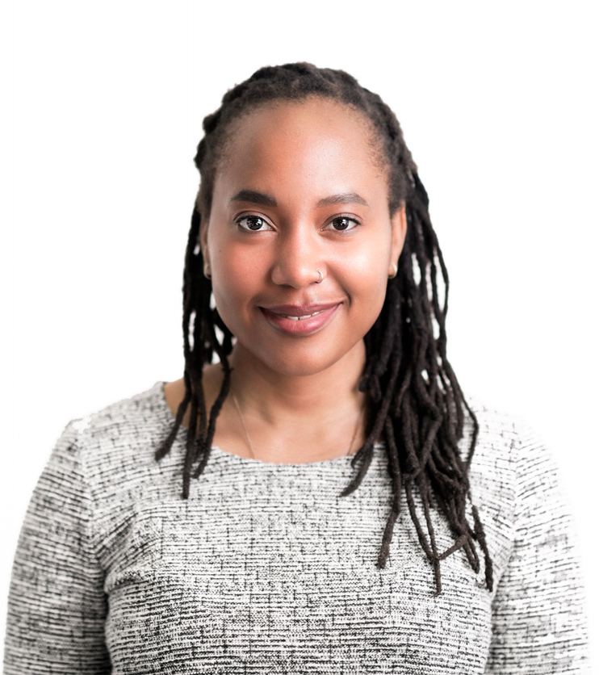
WHY IS In-Person NETWORKING IMPORTANT?
  Most jobs are not advertised. They are filled by someone who is connected (directly or indirectly) to the employer.
  Networking supports career development. It can help you learn about and find careers and jobs.
  Networking helps you build relationships and gives you access to experts.
Copyright © 2019 Accenture. All rights reserved.
Notes:
TIMING (ONLINE CONTENT)
2 minutes
FACULTY INSTRUCTIONS
This slide builds. The slide title displays by default. To reveal the slide content, click the mouse after participants have had a chance to answer the question.
Start by asking participants to volunteer answers to the question. If necessary, provide an example by sharing a brief personal story about how in-person networking has benefited you and/or been important to your career.
After participants have identified several reasons why in-person networking is important, click on the slide to reveal the bullet points.
Key point: You are more likely to find a job by networking.
SUPPORTING CONTENT
Networking helps you build relationships, provides access to experts, and supports career development.
Networking can help you learn about other careers and jobs.
While your online social presence is increasingly important, traditional networking is still the best way to make personal connections.
Networking is something that you should do throughout your career.
Copyright © 2019 Accenture. All rights reserved.
In-Person Networking Workshop Faculty Guide
9

Slide 10
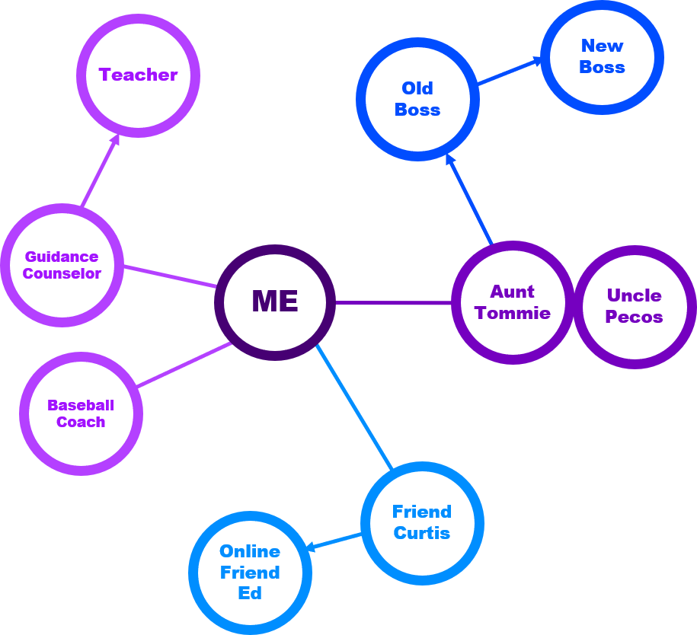

activity: who is in your network?
Goal: IDENTIFY WHO IS IN YOUR NETWORK
Think about the groups of people you know (family, friends, coworkers, classmates, etc.).
On paper, use colored markers to draw a “map” of your current network.
Draw lines to indicate connections and make notes about your connections if you can.
5
min
Copyright © 2019 Accenture. All rights reserved.
Notes:
TIMING
5 minutes
FACULTY INSTRUCTIONS
Ensure each table has paper and markers.
Give learners 5 minutes to draw a “map” of their network on paper.
Urge learners to think of all the people they know – family, friends, coworkers, teachers, classmates, people from church and other organizations, etc.
Copyright © 2019 Accenture. All rights reserved.
In-Person Networking Workshop Faculty Guide
10

Slide 11
Activity DEBRIEF
Teacher
New
Boss
Old Boss
IS YOUR NETWORK LARGER THAN YOU EXPECTED?
WHAT CAN YOU DO TO EXPAND YOUR NETWORK OR MAKE IT MORE DIVERSE?
Guidance Counselor
ME
Aunt Tommie
Uncle Pecos
Baseball Coach
Friend
Curtis
Online Friend Ed
Copyright © 2019 Accenture. All rights reserved.
Notes:
TIMING
10 minutes
FACULTY INSTRUCTIONS
Ask for volunteers to share their network maps and answer the questions on the slide. Respond with observations and questions to draw out insights from participants. For example:
It looks like you have many contacts through your friend Jim. Why do you think that is?
Have you already been using your network for professional purposes, such as to find an internship or job?
Ensure supporting content points are covered before moving on because the workshop assessment includes related questions.
SUPPORTING CONTENT
Anyone can be in your network, but quality is more important than quantity.
Teachers and school counselors (past and present)
Friends, family, and neighbors
Coworkers, peers, and former employers
Neighbors
Team members
Members of your church, band, choir, or other activities
Sports teams
Community groups
Clubs at school, such as band, choir, or theater
In-person networking tips to expand and diversify one’s network include:
Understand who you know and who you need to know. Then ask existing connections to introduce you to people you want to know.
Go to places where you know you’d like to meet people.
Offer to help people you meet (but make sure you can follow through on the offer).
Develop your personal brand (covered on upcoming slides).
Copyright © 2019 Accenture. All rights reserved.
In-Person Networking Workshop Faculty Guide
11

Slide 12
What is branding?
Branding is the process involved in creating a unique name and image for a product in the consumers' mind, mainly through advertising campaigns with a consistent theme.
Branding aims to establish a significant and differentiated presence in the market that attracts and retains loyal customers.
– Business Dictionary
Notes:
TIMING
2 minutes
FACULTY INSTRUCTIONS
This slide builds. The slide title displays by default. To reveal the slide content, click the mouse after participants have had a chance to answer the question. If participants struggle to define branding, then ask them to think about some brands they know and use the supporting content below to ensure the point is understood.
SUPPORTING CONTENT
A good brand will:
Deliver the message consistently, clearly, and credibly.
Motivate the customer and improve loyalty.
Think about well-known brands such as Coca-Cola and Pepsi. These companies convey their brand through product color, design, and logo.
Examples of brands and how they might be perceived:
Walmart: “Save money. Live better” value, low prices, variety of goods
Burger King: Grilled hamburgers, fast food, Whopper
Ford: Trucks, Mustang, American-made, Detroit
Best Buy: Electronics store, televisions, appliances, Geek Squad
Goodwill: Thrift shop, clothes, appliances, costumes, amazing finds
Copyright © 2019 Accenture. All rights reserved.
In-Person Networking Workshop Faculty Guide
12

Slide 13

Personal branding
Creating a personal brand shows others what
you are all about and includes:
Identifying your strengths and
what you want to be known for
Determining your career goals
Coordinating your activities and behaviors to support your goals and personal brand
Identifying people and resources to help continue building your personal brand
Notes:
TIMING
2 minutes
FACULTY INSTRUCTIONS
Explain that personal branding is the same as branding but you – the person – is the product.
Share a brief explanation of your personal brand and provide a personal brand statement.
Emphasize that a personal brand is important in making a first impression, so participants should begin developing one if they don’t already have one.
Review the high-level steps for developing one’s personal brand (on the slide).
Tip: If you have a difficult time identifying your strengths or what you want to be known for, then ask others how they perceive you.
Note: Personal brand is touched on here so that participants can use “personal brand words” in their elevator speeches to describe their strengths and qualifications. They do not need to develop a full personal brand or personal brand statement at this point. The topic of personal brand is covered more extensively in the Online Networking course.
Copyright © 2019 Accenture. All rights reserved.
In-Person Networking Workshop Faculty Guide
13

Slide 14

Elevator speech video
https://www.youtube.com/watch?v=LDpe9StfGTA
ELEVATOR SPEECH VIDEO
Notes:
TIMING
5 minutes
FACULTY INSTRUCTIONS
Give the video a moment to load from YouTube. You may need to watch a few seconds of an ad and then click Skip Ad.
Play the video The Elevator Speech (2:43) to demonstrate poor examples of an elevator speech.
After the video, facilitate a brief discussion about it. For example:
How many of you have been in a similar situation?
What did you notice people doing correctly in the video?
What did you notice that was done incorrectly?
Conclude the discussion by emphasizing the importance of being prepared with an elevator speech. It can be used in a variety of situations, not just in an elevator.
Copyright © 2019 Accenture. All rights reserved.
In-Person Networking Workshop Faculty Guide
14

Slide 15

WHAT IS AN
Elevator speech?
A short 30 to 60 second speech about you
To start a conversation or respond when someone says, “Tell me about yourself…”
Depending on the audience, it should include:
  Introduction
  Personal branding words
  Qualifications and experiences
  Call to action
Notes:
TIMING (ONLINE CONTENT)
5 minutes
FACULTY INSTRUCTIONS
This slide builds. The slide title displays by default. To reveal the slide content, click the mouse after participants have had a chance to answer the question.
Remind learners that the phrase “elevator speech" means the summary should be brief and concise enough to be delivered in a short time span, such as an elevator ride. It does not necessarily happen in an elevator. It can be used in different situations to network, such as a job fair or a more casual setting.
Remind learners that it is a description of who you are, what you do, what you are interested in doing, and how you could help the listener. Think of an elevator speech as a verbal “cover letter.” It is designed to start a conversation, specifically when someone says, “Tell me about yourself…”
Be interesting and authentic!
Follow up with people you meet within 24 hours and thank them for their time. Be sure to include a note from the conversation to refresh their memory and consider scheduling a time to meet again.
Copyright © 2019 Accenture. All rights reserved.
In-Person Networking Workshop Faculty Guide
15

Slide 16
INSTRUCTOR
DEMONSTRATION
ELEVATOR SPEECH
Copyright © 2019 Accenture. All rights reserved.
16
Notes:
TIMING
2 minutes
FACULTY INSTRUCTIONS
Instructors will demonstrate a proper elevator speech as a model for what participants will do in the upcoming activity.
Keep your elevator speech to one minute or less and remember to customize it for your audience.
If you have a large number of instructors, then not everyone needs to give an elevator speech (due to time constraints).
Copyright © 2019 Accenture. All rights reserved.
In-Person Networking Workshop Faculty Guide
16

Slide 17
Activity: CREATE YOUR ELEVATOR SPEECH
Goal: draft your elevator speech
Imagine: You run into someone who works at a company you really want to work for OR who has a job you would love to have. What would you say to them?
Use the Elevator Speech Worksheet to create an elevator speech (30 to 60 seconds) for this situation.
15 min
17
Notes:
TIMING
15 minutes
FACULTY INSTRUCTIONS
Distribute the Elevator Speech Worksheet, which provides a template for learners to complete their elevator speech.
Instruct learners to follow the slide instructions and use the Elevator Speech Worksheet to create one elevator speech that is approximately 30 to 60 seconds.
Encourage participants to look at the examples in the Elevator Speech Worksheet for ideas.
Instruct participants to start practicing their elevator speech when they have completed the worksheet.
Circulate around the room, providing guidance as necessary.
Inform participants that they can modify this elevator speech in the future to use for different situations.
Copyright © 2019 Accenture. All rights reserved.
In-Person Networking Workshop Faculty Guide
17

Slide 18
Activity: PRACTICE YOUR ELEVATOR SPEECH
Goal: PRACTICE AND CRITIQUE ELEVATOR SPEECHES
Round ONE
Round TWO
Find a partner.
Speaker delivers elevator speech (1 minute)
Listener fills out Feedback Form and shares feedback (2 minutes)
Switch roles and repeat step 2 and 3.
Find a NEW partner.
Repeat steps from Round ONE.
20 min
18
Notes:
TIMING
20 minutes
FACULTY INSTRUCTIONS
Conduct this activity in two rounds as described on the slide. Ensure each participant has two Elevator Speech Feedback Forms – one for each round.
Each round takes approximately 6 minutes, but extra time is provided for instructors to set up the activity and for participants to pair up.
Carefully manage time for this activity by setting a timer or having one instructor responsible for managing time while the other observes.
Observe and listen to speeches and provide any additional feedback or coaching you see fit.
Encourage participants to provide both positive feedback and areas for improvement.
Note: If extra time is available, consider:
Let participants revise their speeches after the first round
and/or use that time to answer participants’ questions
Copyright © 2019 Accenture. All rights reserved.
In-Person Networking Workshop Faculty Guide
18

Slide 19

ACTIVITY debrief
WHAT DID YOU LIKE BEST ABOUT HAVING AN ELEVATOR SPEECH?
WHAT DID YOU FIND MOST DIFFICULT ABOUT CREATING OR GIVING YOUR ELEVATOR SPEECH?
Copyright © 2019 Accenture. All rights reserved.
Notes:
TIMING
5 minutes
FACULTY INSTRUCTIONS
Facilitate a discussion using the questions on the slide.
Inform participants that it is natural to be nervous when networking and asking people for help. It will get easier with practice, and in general, most people will be genuinely excited to help you or connect you with someone who can.
What did you like best about having an elevator speech? Possible answers may include:
It’s nice to have something prepared when people ask me about myself.
I can use this speech in the future or change it and use it for other situations.
What did you find most difficult about creating or giving your elevator speech? Answers may include:
It was challenging to identify my skills and qualifications/use personal brand words.
I didn’t know what to highlight and what to leave out.
It was difficult keeping it under a minute.
It didn’t sound natural.
I didn’t know what to say for the certain parts of the speech.
I’m not comfortable talking about myself, making eye contact, etc.
Copyright © 2019 Accenture. All rights reserved.
In-Person Networking Workshop Faculty Guide
19

Slide 20

Elevator speech tips
Do:
Don’t:
  Revise your speech to sharpen its focus.
  Speak confidently and enthusiastically.
  Be sincere. Be yourself. Show your personality.
  Prepare for different situations.
  Practice until you’re comfortable with it
  from start to end.
  Rush through it breathlessly.
  Sound robotic or unnatural.
  Make an over-rehearsed presentation.
  Use industry jargon or acronyms or slang.
  Forget to watch for
  nonverbal cues.
Notes:
TIMING
3 minutes
FACULTY INSTRUCTIONS
Ask participants if they did any of the “dos” during their speeches today. Discuss.
Ask participants if they have any tips for avoiding the “don’ts” when giving an elevator speech.
Wrap up the discussion by encouraging participants to continue practicing their elevator speech after the workshop.
Copyright © 2019 Accenture. All rights reserved.
In-Person Networking Workshop Faculty Guide
20

Slide 21

WHAT WILL YOU DO NEW OR DIFFERENTLY BASED ON WHAT YOU LEARNED TODAY?
Notes:
TIMING
4 minutes
FACULTY INSTRUCTIONS
Give participants a “call to action” to make networking a habit by regularly applying what they learned today.
Call on one or more participants to answer the question on the slide.
Possible responses include:
I’ll start introducing myself to more people.
I will try to reconnect with people I know who could be valuable to my network.
I will try to reconnect with people who I might be able to help.
I will make my network more diverse.
I will start being more aware of the impression I’d like to make on people.
I will work on developing my personal brand.
Copyright © 2019 Accenture. All rights reserved.
In-Person Networking Workshop Faculty Guide
21

Slide 22
Thank you!
Please complete the Workshop Assessment and Feedback Survey now.
https://ccusa-lms.cclearning.accenture.com/course/view.php?id=450
Copyright © 2019 Accenture. All rights reserved.
22
Notes:
TIMING
1 minute
FACULTY INSTRUCTIONS:
Instruct participants to take the workshop assessment on the Learning Exchange course page. They must pass the assessment to be marked complete.
Encourage participants to complete the feedback survey. Thank participants in advance for sharing their opinions. Remind them that their input helps Accenture improve the workshop and that their responses are confidential and anonymous.
Copyright © 2019 Accenture. All rights reserved.
In-Person Networking Workshop Faculty Guide

